Slide 1



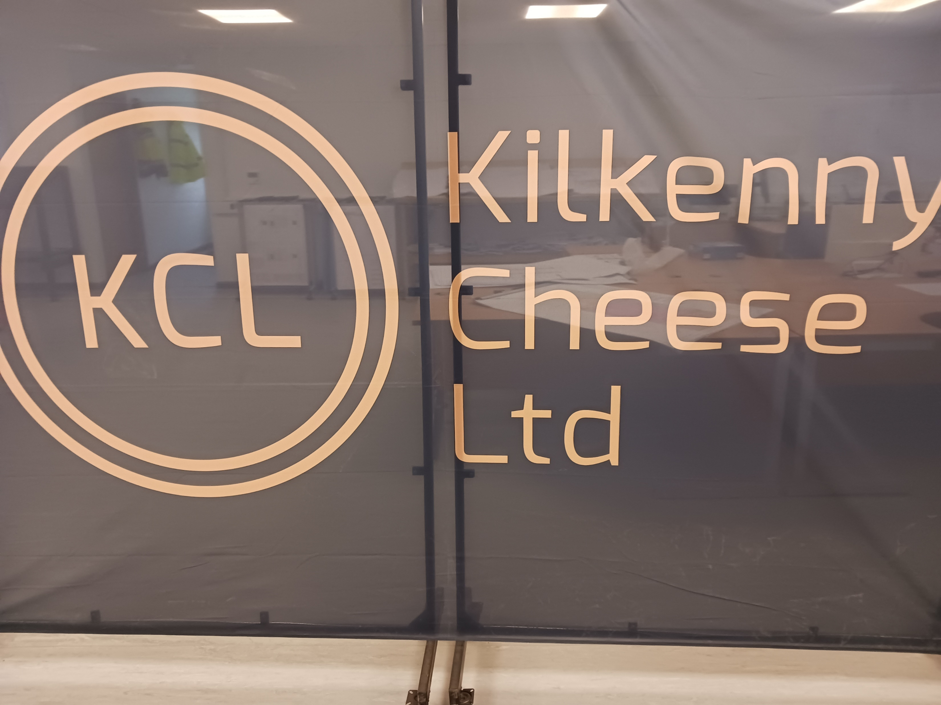
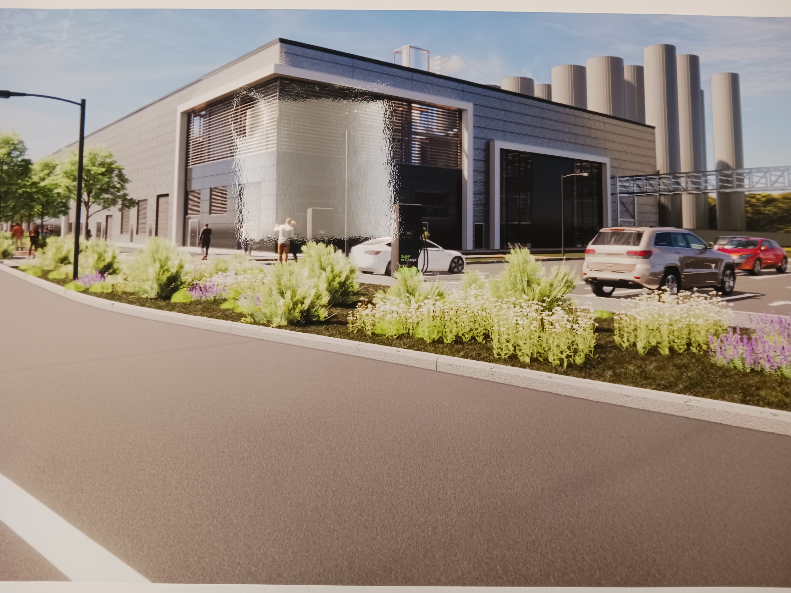

Title: IMSL-EHS-03 EHS Site Induction
Revision: 1
Date: March 2021
Suir Engineering EHS Induction Kilkenny Cheese
www.suireng.com

